Slide 1
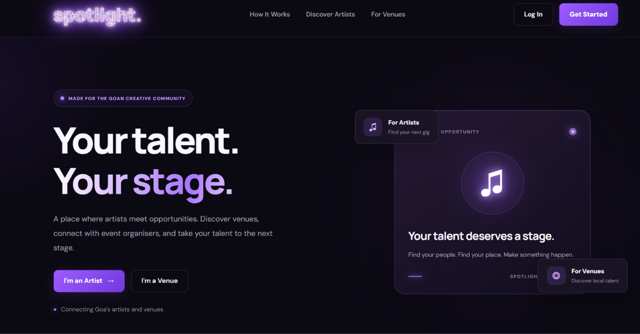
MINI-PROJECT DEMONSTRATION
spotlight.
Your Talent. Your Stage.
An artist and venue discovery platform for Goa
A shared place to create profiles, discover the community and manage account details.
Kreisler Mozart Goes · 2625
Kevin Fernandes · 2624
MCA · Goa University
SPOTLIGHT / MINI-PROJECT

Slide 2
01 / CONTEXT
Why Spotlight?
The project focuses on discovery challenges faced by artists, venues and event organisers.
01
02
03
Discovery is fragmented
Profiles lack a shared home
Opportunities are hard to scan
Artists and organisers may rely on separate social pages, personal contacts and word of mouth.
Basic details such as location, talent category, description and portfolio links can be scattered.
A focused discovery page can make local creative people and performance spaces easier to browse.
INTENDED COMMUNITY
ARTISTS
VENUES
ORGANISERS
Singers · musicians · DJs · performers
Restaurants · event spaces · music venues
People seeking talent for events
Project context: designed for the Goa creative community.
02

Slide 3
02 / GOALS
Objectives and project scope
The minimum viable product prioritises account roles, cloud profiles and discovery.
01
Separate user roles
IN THE CURRENT MVP
Artist and venue accounts share authentication but use different dashboards.
• Public landing page
• Email/password registration and login
• Artist and venue profile dashboards
• Profile updates saved in Firestore
• Community feed from stored profiles
• URL-based profile / venue images
02
Store profile details online
Save and retrieve profile information through Cloud Firestore.
03
Support community discovery
Display artist and venue cards with available descriptions, locations and images.
NOT YET IMPLEMENTED
04
Enable self-service editing
• Direct image-file uploads to managed storage
• Booking and application workflow
• Messaging and in-app notifications
• Verified listings and production deployment
Let users update their own profile details without re-registering.
Design choice: build a usable discovery foundation first; defer features that require more infrastructure.
03

Slide 4
03 / SOLUTION
How Spotlight works
The public page introduces the service; signed-in users browse the community and manage their own account.
1
2
3
4
5
6
Public homepage
Register / log in
Firebase Auth
Community feed
Open a profile
Account dashboard
Understand the service
Email and password
Verify identity
Browse profiles
View public details
Edit own details
ROLE-SPECIFIC EXPERIENCE
ARTIST ACCOUNT
VENUE / EVENT ORGANISER
Category, description, location and profile image URL; discover venues and event spaces.
Venue type, description, location, profile image URL and venue photo URL.
04

Slide 5
04 / IMPLEMENTATION
Technology stack and architecture
A lightweight browser application connects directly to Firebase using its web SDK.
BROWSER CLIENT
HTML structure · CSS styling · JavaScript validation, navigation and Firebase SDK calls
FIREBASE AUTHENTICATION
CLOUD FIRESTORE
Create account · sign in · sign out
Read and update /users/{uid} profile documents
DEVELOPMENT
IMAGES AND SERVER
Visual Studio Code and Live Server are used to run the static pages locally during development.
The current version stores image URLs in profile documents. It does not upload image files to Firebase Storage, and uses no custom Node/Express server.
05

Slide 6
05 / DATA DESIGN
Profile data model
Artist and venue details are stored as role-specific fields in a Firestore user document.
Firestore document: users/{uid}
COMMON FIELDS
uid
email
fullName
accountType
location
createdAt
ARTIST-SPECIFIC FIELDS
VENUE-SPECIFIC FIELDS
artistCategory
venueType
description
description
profileImageUrl
profileImageUrl · venueImageUrl
Conceptual document schema. These are data fields, not separate JavaScript classes.
06

Slide 7
06 / UML DESIGN
Use-case diagram
Artist and venue users share account access and discovery, but manage separate role-specific profiles.
SPOTLIGHT WEBSITE
Register / log in / log out
Browse feed and view profiles
Artist
Venue / organiser
Edit artist profile
Edit venue profile
Solid associations show available actions. Artist and venue users edit only their own profile type.
07

Slide 8
07 / SYSTEM BEHAVIOUR
Sequence: authentication and profile discovery
How the browser verifies a user, retrieves the role profile and loads community listings.
User
Spotlight UI
Firebase Auth
Cloud Firestore
1. Enter email and password
2. Create account or sign in
3. Return authenticated user / UID
4. Read users/{uid} profile
5. Return role and profile fields
6. Query profile documents for discovery
7. Return public listing data
8. Render feed and role-specific Account link
Authentication is handled by Firebase Auth; profile and discovery data are read from Cloud Firestore.
08

Slide 9
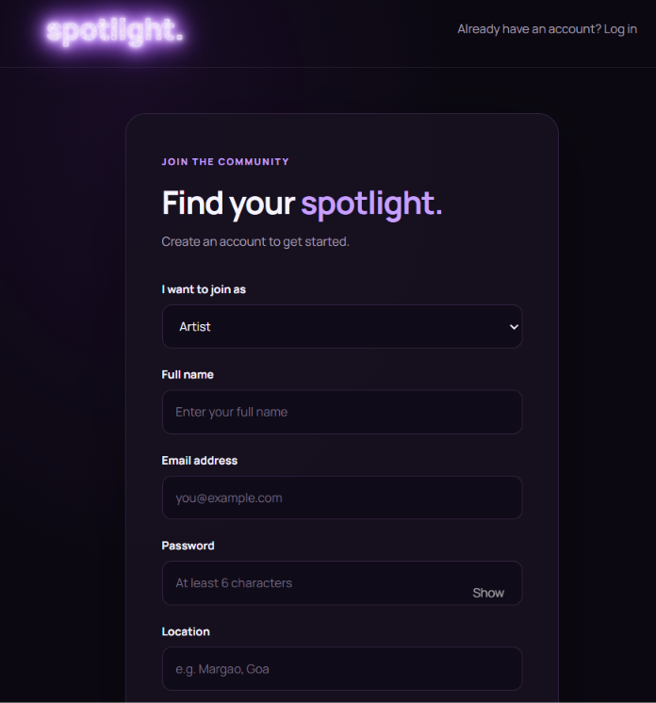
08 / PRODUCT WALKTHROUGH
Public homepage and authentication
The landing page introduces Spotlight; registration and login provide access to the community.
PUBLIC HOMEPAGE
Brand identity, purpose and entry points for artists and venues.
REGISTRATION
Role selection, profile details and password visibility.
09

Slide 10
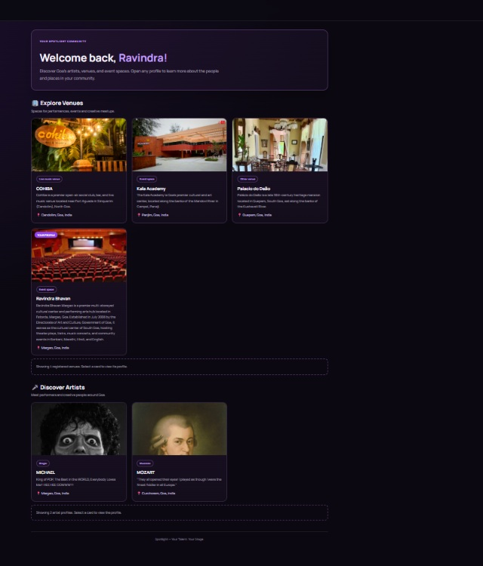
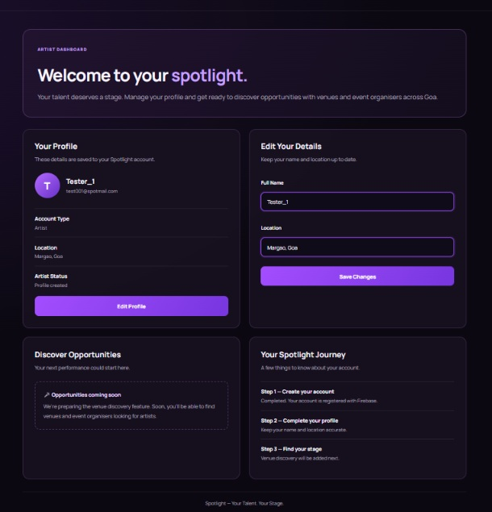
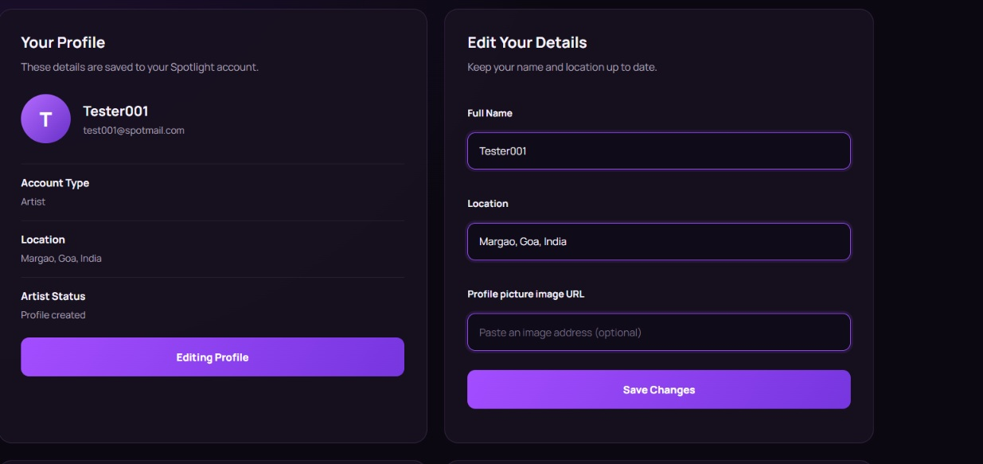
09 / PRODUCT WALKTHROUGH
Community feed and profile management
The feed reads artist and venue profiles from Firestore; users can update their own details.
EDIT PROFILE
Changes are saved to the matching Firestore user document.
CURRENT IMAGE METHOD
Profiles store image URLs. The URL must be accessible for the browser to display it.
ARTIST ACCOUNT
View saved details and edit the profile.
COMMUNITY FEED
10

Slide 11
10 / VERIFICATION
Testing, results and current limitations
Manual functional checks were performed while developing the prototype using Live Server and Firebase.
FUNCTIONAL CHECK
OBSERVED RESULT
STATUS
Registration and login
Firebase Authentication creates and verifies test accounts.
Observed
Profile editing
Name, location and image URL save to Firestore.
Observed
Community feed
Artist and venue documents render as discovery cards.
Observed
Image rendering
Accessible image URLs display; external hosts may block requests.
Conditional
Password reset
Implemented; not verified with the invented test mailbox.
Not verified
LIMITATIONS / NEXT STEPS
Direct image uploads · bookings and messaging · refined public/private profile data · deployment and broader testing.
11

Slide 12
Thank You

